Slide 1
DEVELOP AN OUTCOME L2
Evidence of Learning Template
18036
Uno game
Krish Patel

Slide 2
Github /Drive linkhttps://drive.google.com/file/d/1kavH0qEyg7g3gbelMpPo00JsdzZVCMA0/view?usp=sharing
https://trello.com/b/HZKnJMIL
You MUST provide evidence showing how the problem has been decomposed, how the components have been developed and trialled, and of how they have been assembled and tested to create a final, working outcome.

Slide 3
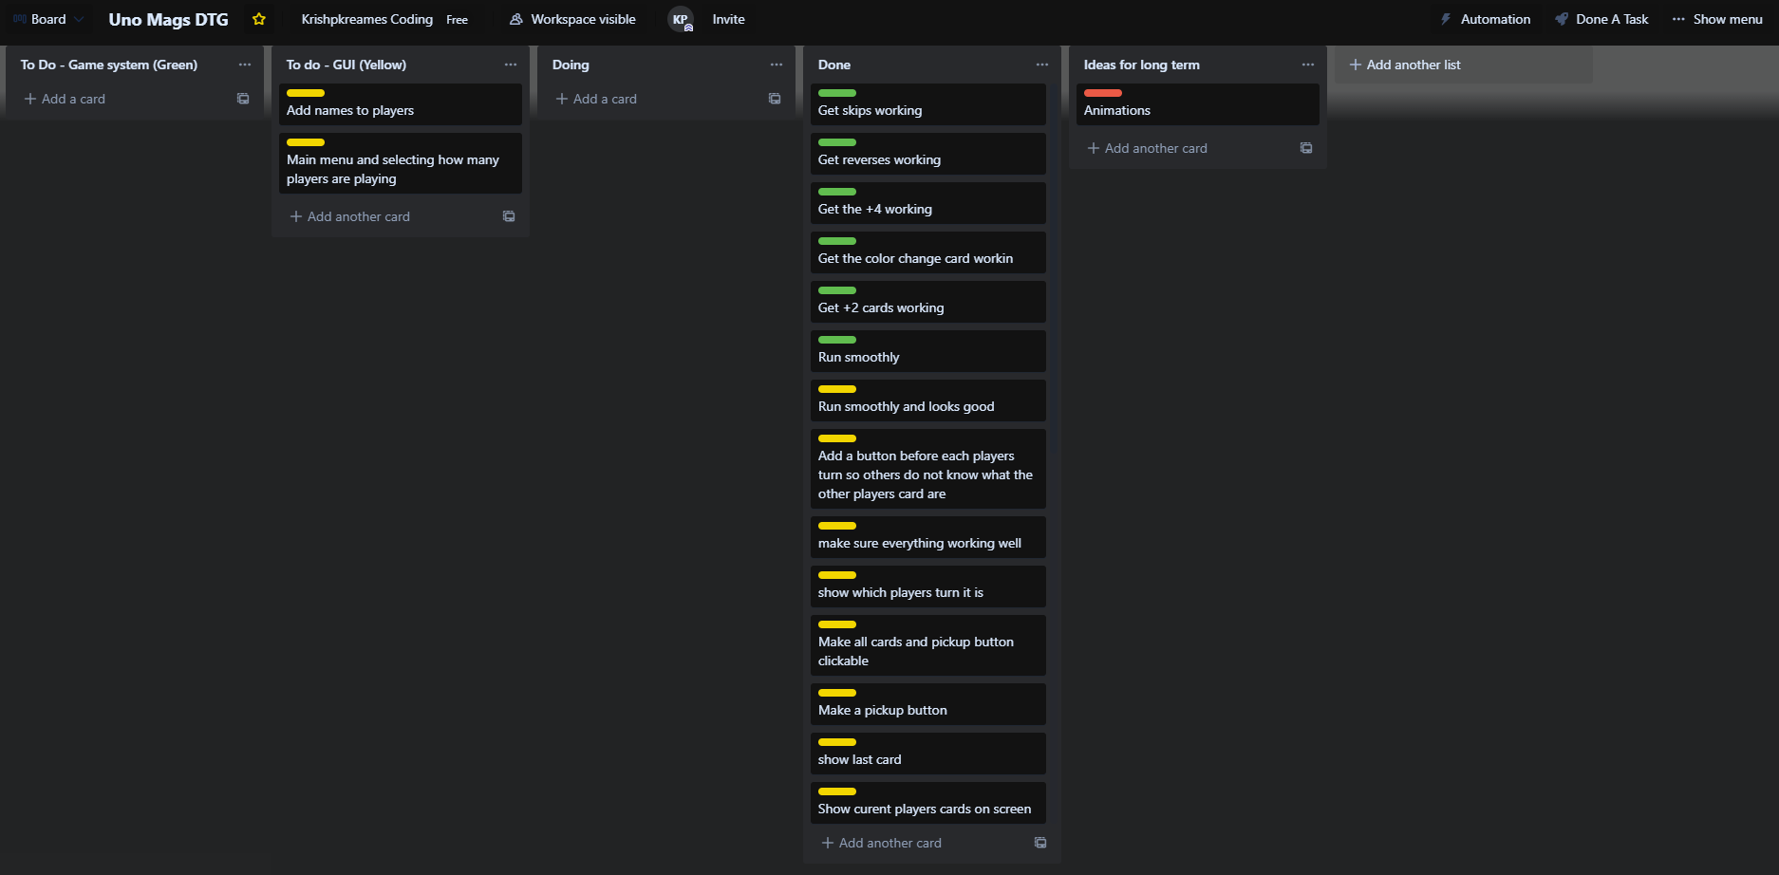
Project management: Setup
Record evidence that you have setup project management tools to manage the development of your outcome.
I used a trello board to manage my project. When I initially decided on a idea for my project i used trello to set out my ideas for the project. I used 1 or 2 days to plan the parts of the project such the gui and the game system. I can prove this by showing my trello board at https://trello.com/b/HZKnJMIL. It was very useful while I tried to manage this project. Other that this I used the notes on my laptop to just brainstorm ideas of what I need to complete in my project. Eg…
Get the power cards to do their own jobs. (+2 adds 2 cards to next player)
Get the card validation system workings.
Learn how to use tkinter or some other python gui module.
Learn the rules of Uno so I can implement into my project.
Find images of the all cards of the game and rename them.

Slide 4
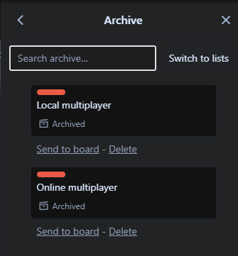
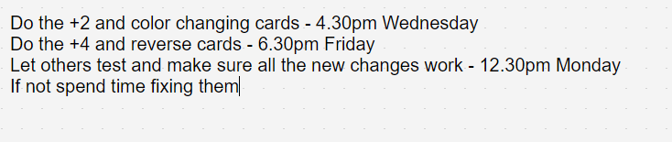
Project management: Setup
Record evidence that you have chosen project management techniques to manage the development of your outcome.
2 project management techniques I used while making this project was archiving and and setting reminders.
When making the trello board instead of deleting a card, I decided to to archive them so that if in the future it turns out to be a good idea which previously I did not have time or skills for, but do now I can revisit the idea instead of letting it go to waste.
I also started setting reminders on my phone that I needed to complete things at home.

Slide 5
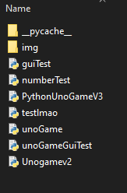
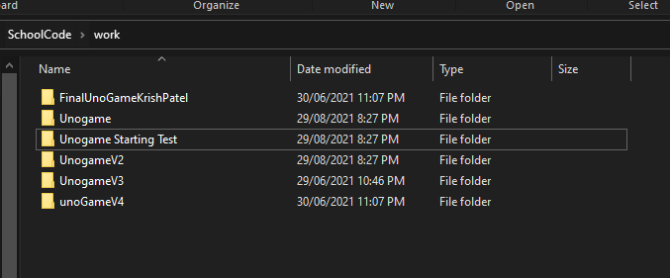
Project management: Setup
Record evidence that you have setup/ chosen version control tools/techniques to manage the development of your outcome.
I decided that everytime I would finish coding an important part of the project such getting the GUI working I would duplicate the file I was working and continue working that the new file. This way it will leave different versions of the project, and rolled back to if something were to happen.

Slide 6
Project management: Setup
Explain why you believe that these tools and techniques are appropriate for the development of your outcome.
I feel that the tools and techniques that I used to create this project were appropriate as they greatly increased my productivity rate as I knew what I what doing at all times and managed the flow of work I was able to do. The use the trello board made it so I could constantly change it, and see how much progress I have made when I move cards from doing the done. Since Trello is website and loaded on the cloud I could switch devices and all my work would still be there. While researching project management methodologies I found the waterfall methodology which I found very useful to manage my project. I personally felt that planning everything at the start and brainstorming, making a trello board. Then checking things off as I completed them, part by part was very easy for me personally and felt that the use of this greatly increase my productivity rate. Time management techniques such as reminder was one of the reasons I stayed focus which is why it was appropriate to for the development of my project.

Slide 7

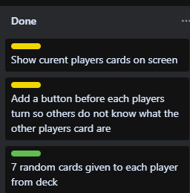
Decomposing outcome
Record evidence that you have broken the outcome into smaller components.
I started by thinking about what I had to finish in my project. I decided to make uno with python but I did not want a console IO system, I wanted a GUI like a real application. So that is where I decided to start breaking my workload. I thought of all the things I needed to complete game system wise and graphic wise. I broke the uno game rules up and set each on as a task, tasks such as “Add a last card that changes depending on what cards was put down last”. And I thought of the apps I use on a regular basis and the key components in them, and I thought of easy to use buttons, and brief information so you are not confused while using the app. So I got the GUI idea and broke it down into smaller parts life “Show current players cards on screen” and “Add a button before each players turn so others do not know what the other players card are”.

Slide 8
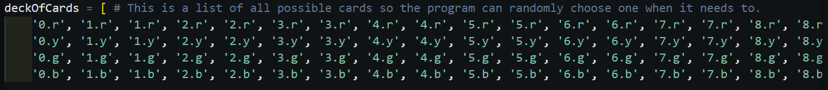
Trialling components
Record evidence that you have trialled components. Show that you gathered information to inform your decision making.
I trailed individual components such as card pick up system and player hand randomizer. And decided if the component was good enough to be used or not in my project. My card pickup system is pretty good, I started my adding a button in the GUI that allows the player to pick up a card and move to next turn. The card is randomly selected from a uno deck, the decks probability of each specific cards being picked is accurate, the +4 and color changing cards are half as likely to be picked up than any other card. I decided to make the +4 and color changing show up less is players hand because that is how it is in the original game and after trailing I found I was getting too many +4 and color change cards which are quite powerful in the game of uno.

Slide 9
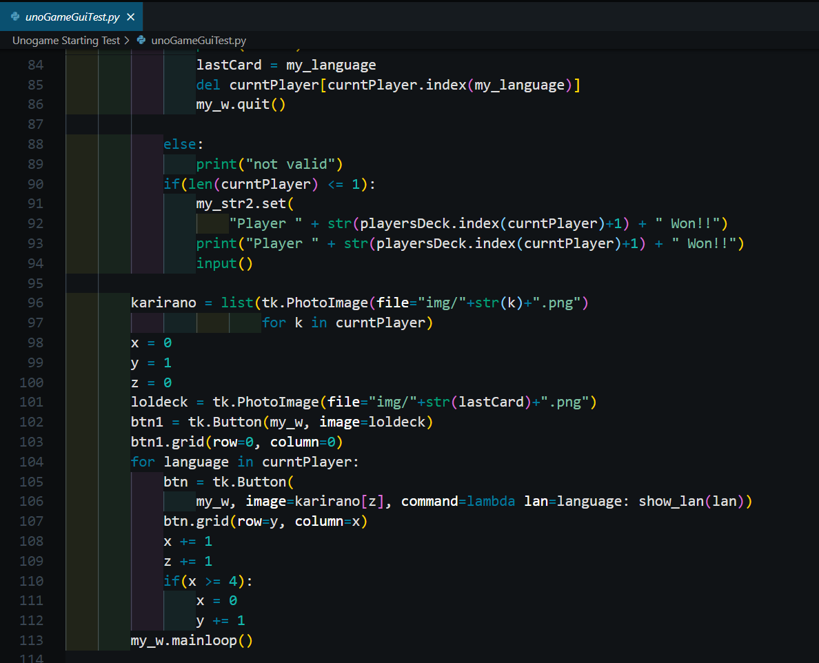
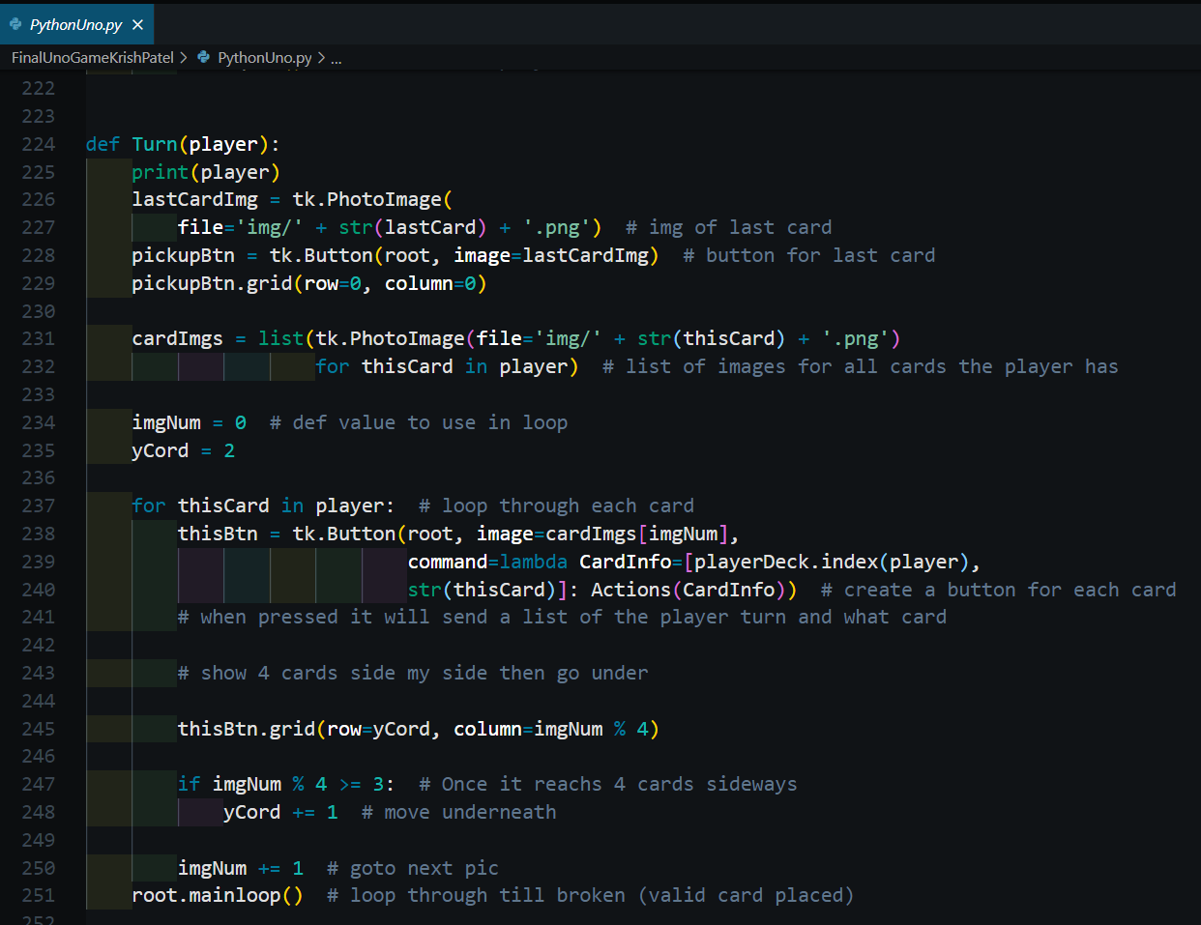
Trialling components
Record evidence that you have trialled multiple components and have selected those most suitable.
During the project I had tried multiple different components and found the most suitable. An example of this is my card showing GUI, I had two versions of this. The first one I made was quite good, it worked at showing the cards but would not delete the cards after the players turn was over this is because during this version I did not have multiple players in the game yet. Therefore I made another version of the card showing GUI which changed these problems but had problems with laying the cards in rows of 4. I decided to use the second version as after I trailed it and found a workaround the the card problem which was to decrease the width of each card. That is how I decided which of the 2 is more suitable for my project.

Slide 10
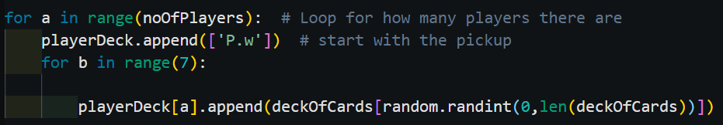
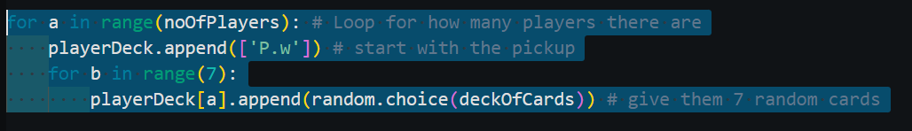
Trialling components
Record evidence that you have used information from trialling appropriately to improve the functionality of the outcome.
I used the information I got from trailing my components to improve the project an example being the +4 and color change card rarity but another example is the player hand randomizer. I originally was using randint to get random element from list to add to the player hand, but after researching the the random module I found that sample and choice function. And made a new version of the player hand randomizer with choice instead of randint and I trailed both and they both worked but I found that the choice function worked a bit faster. From that information and the research I did I came to the conclusion that the player hand randomizer that uses the choice function is the one I will use the the project. It archives the same output while being faster therefore improving the functionality of the outcome, outcome being allowing player to play their turns.

Slide 11
Testing outcome
Record evidence that you have tested your outcome.
I ran the code on two devices, my windows PC and my laptop and both worked perfectly.
https://drive.google.com/file/d/1IwT8Hl2Y4cNz6U907Il44uS36_nmCAEs/view?usp=sharing

Slide 12
Testing outcome
Explain how the testing made sure your outcome functions as intended to meet its purpose and requirements.
The testing made sure the game works as intended you select how many players are present, the game gives that amount of randomized hands, each player has their turn, the card validating system works, the ready button works as intended that add +2 cards and all the power cards work as intended. It meets the purpose of being a game of uno. And the requirements such as the game system work like the original game.

Slide 13
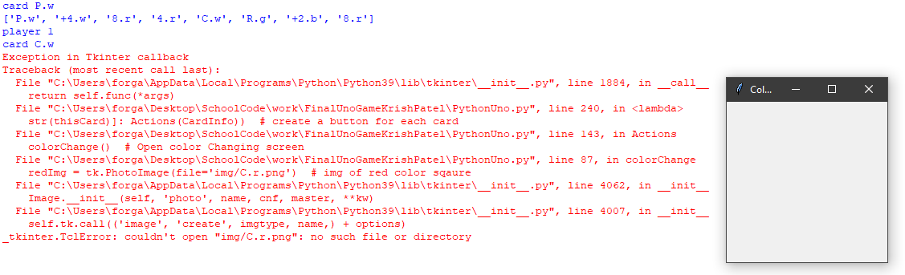
Testing outcome
Record evidence that you have used information from testing appropriately to improve the functionality of the outcome.
From previous testing there was an error that was occurring when I tried it testing on my laptop where the color selecting screen was not coming up and was throwing an expectation that the image file to show the different color couldn't be found even tho it was working on my PC. It turned out that it was due the an error while I transferred the images over the file was not in the correct folder.

Slide 14
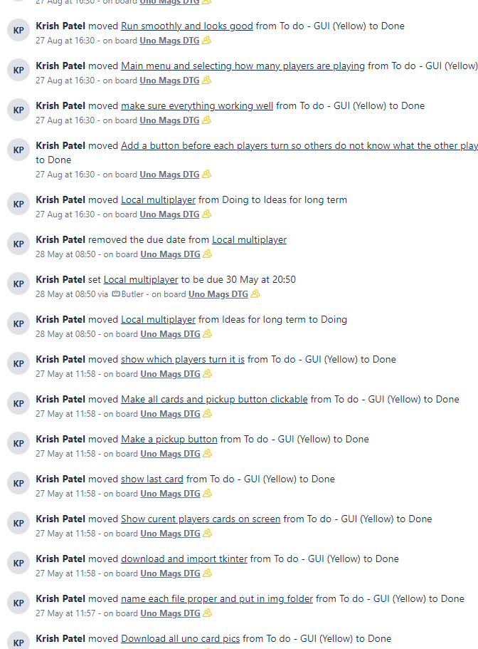
Project management: Applied
Record evidence that you have used your project management tools to manage the development of your outcome.
Throughout this project I used trello as a project management tools because it helped me managed what work I had left to do, the history Trello keeps of my moves can prove this.
https://trello.com/krishpatel58/activity

Slide 15
Project management: Applied
Record evidence that you have used your project management techniques to manage the development of your outcome.
Techniques like reminders and archiving helped me during this project an example for archiving was the ready button in between player turns so the players don't know what the other players cards are and play accordingly. I initially archived that idea but after a bit I decided to implement it into the project. And the reminders on my phone keep me on track so I was steadily getting through the workload.

Slide 16
Project management: Applied
Record evidence that you have used version control tools to manage the development of your outcome.
Throughout this project when I finished a important part of code I would duplicate my file and keeping working on the new file, making versions throughout the project making it easier to backtrack if I ever had to. I had many versions of my project, I started by testing individual parts of the project like the GUI, deck randomizer, and card indexing system.

Slide 17
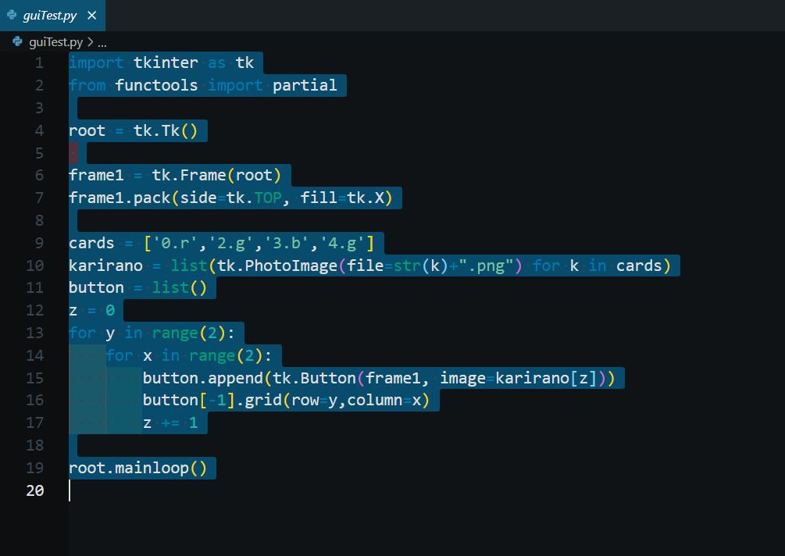
Version Control
I started by testing the GUI and understanding how tkinter worked. I just downloaded the images and tried making 4 buttons.

Slide 18
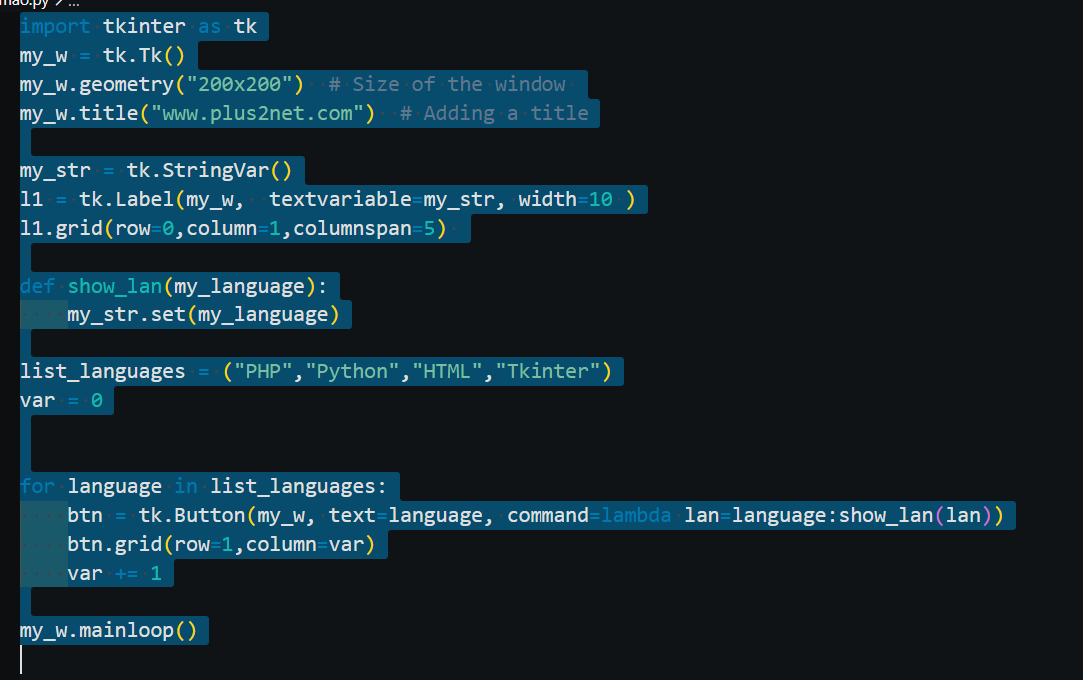
Version Control
The next time I did is try to make buttons do something. Problem I had is I could not make the buttons in a loop but have each one do a different task. After some searching I found this piece of code and I modified it a little. And tested to see how it would work. It worked well!

Slide 19
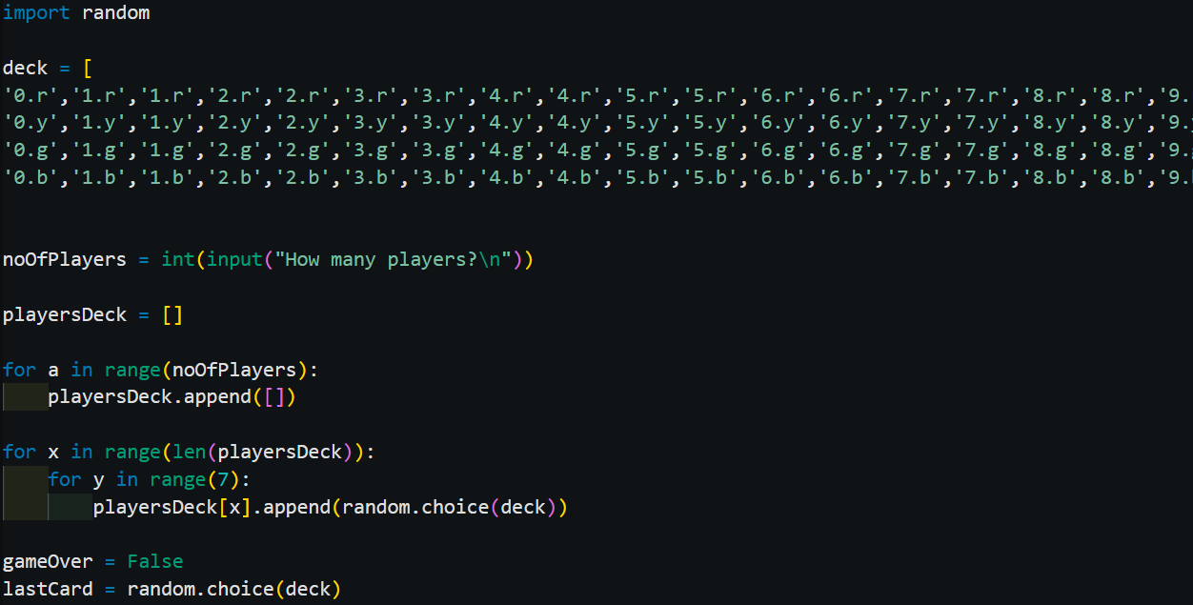
Version Control
Next I started working one my game system so the game can be played smoothly and according to the original games rules. I started by getting player hands, and giving each 7 random cards from deck.

Slide 20
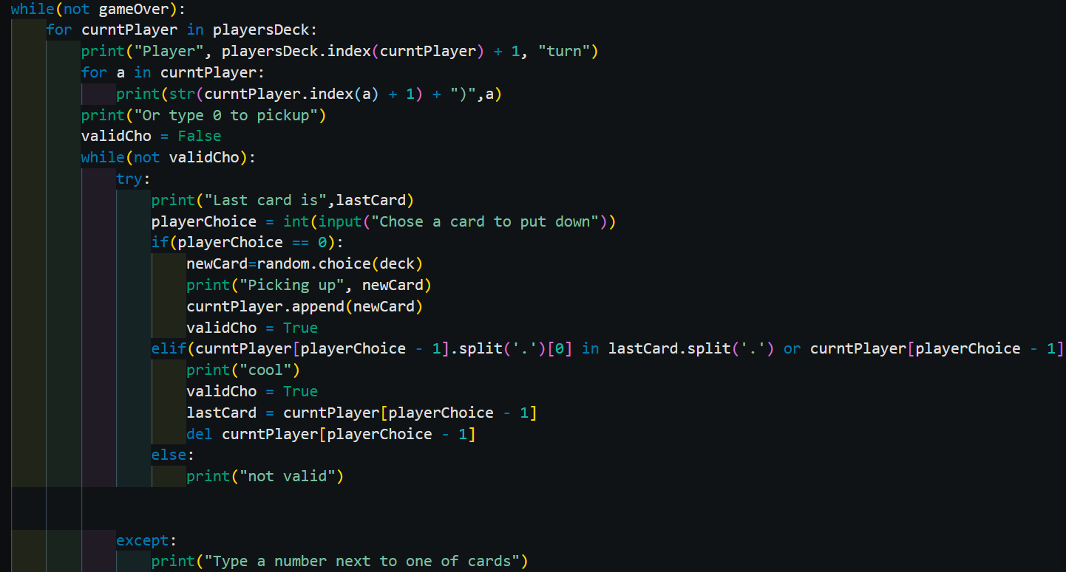
Version Control
After that I got the input system working, but it was using the console OI system which was not very good. I did this so I could understand the way I needed to code the game system and I made a working game system this way.

Slide 21
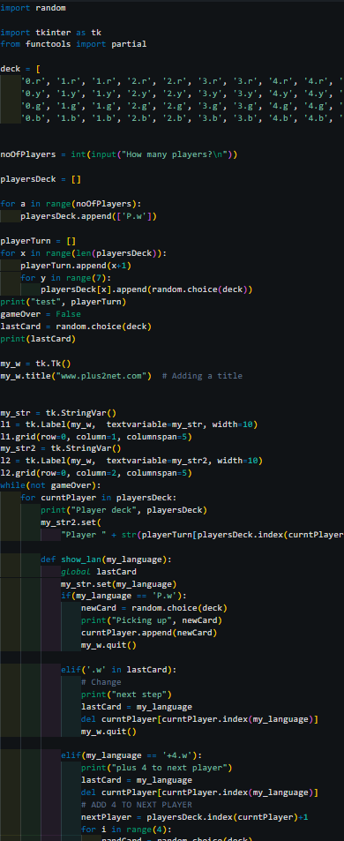
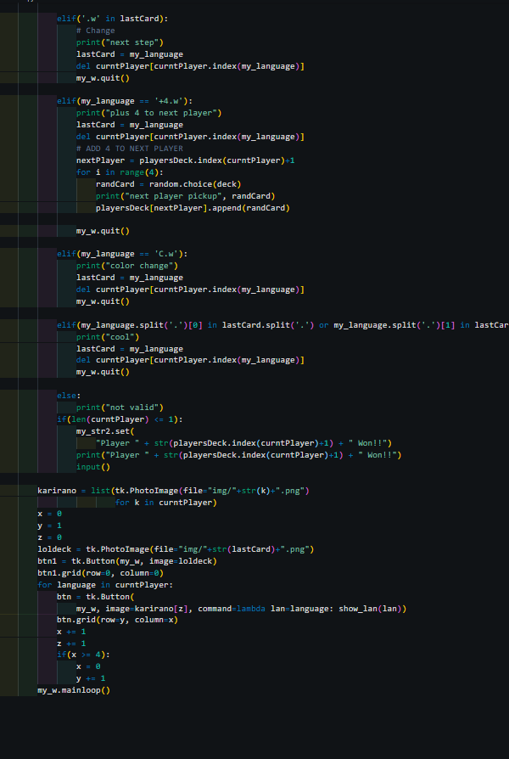
Version Control
Next I combined the two major parts together and made it so that the cards were displaying the current players hand. I implemented the game system into the GUI I had already created. And it worked as a test quite well. But it had many errors and the power cards did not work.

Slide 22
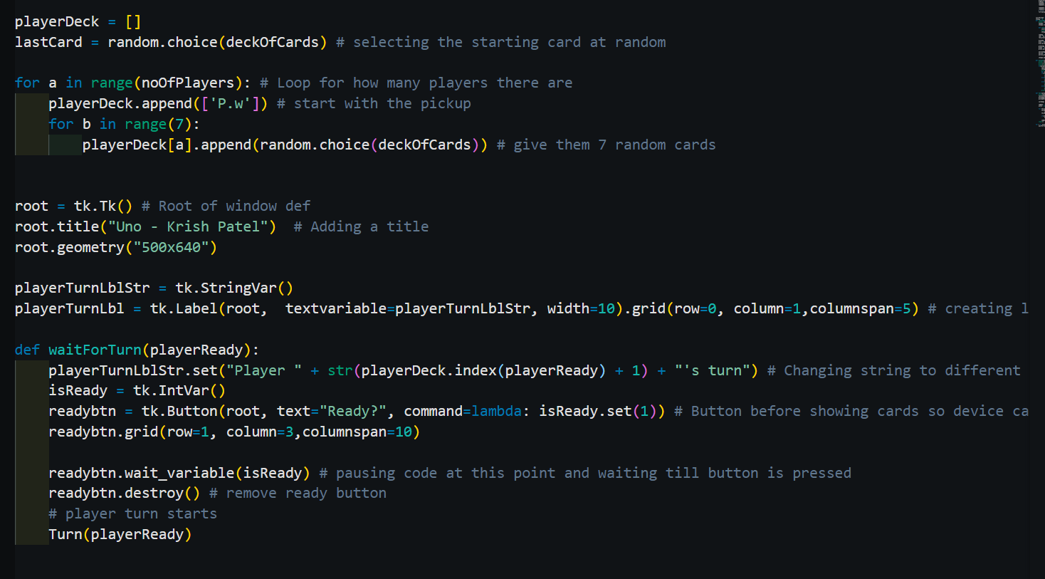
Version Control
Once I had the test done I spend the next few weeks iteratively changing the program adding a small part and making sure everything worked, testing it. And then adding the next small part. In the end I had my final version of the game.

Slide 23
Relevant Implications
Explain the relevant implications here. Please watch this video to learn how to do this.
Legal - All the code in my project was written by me and not copied and pasted from another source. And all the images I used for the cards were not taken by me, but were collected legally from a website that allows people to download such pictures for free.
Functionality - The code works well and it is quite fast, their is partially no delay between the inputs and the diserited output. The code allows the game to run well and the game follows all the uno rules like you can only place a card that is the same color or number as previous. And works quite well at seamlessly merging the input and playability of the uno game.
Aesthetics - I feel that the images, font, background color work very well at giving the GUI of the game a good looking. After talking to a few friends they think that the GUI is a lot more aesthetically pleasing than the console IO that would that to be used if the GUI was not.

Slide 24
Relevant Implications
Explain the Implications that are relevant to your outcome.
The reason the implications listed are relevant to my outcome is that legal, functional and aesthetics are important to this project. If I were to publish my game I would need to make sure that I got the images legally, and that they are not copyrighted. I went on a website that allows me to download them for free. It was a uno card information database. Functionality was important because I needed anyone to be able to play the game if they knew the how to play uno. And that would be quite hard if i were to use a console IO system, that is why I decided to use tkinter and make a GUI. Aesthetics I believe that although it is not the best looking game, my testers think it is definitely more fun and visually appealing to use tkinter and make a GUI than use the console.

Slide 25
Relevant Implications
Record evidence that you have addressed the Implications that are relevant to your outcome.
I legally sourced images from the uno card informational database. And aesthetics are good as it is not a console game. And the functionality is good because it allows anyone to play the game.

Slide 26
Evaluate
Discuss how the information from planning, testing and trialling of components assisted in the development of a high-quality outcome.
Throughout this project many things have allowed me to create a high quality game of uno with python, such as planning everything and breaking down parts of the game. Slowly working through parts of the game and testing the trailing specific parts and iteratively making changes till it was a high quality component I could implement into the project. And the use of many different project management tools and techniques assisted me in the development of my python based uno game. It tools quite some work but I personally am quite proud of it.

